Slide 1

It’s time for…
You Tell Me!

Slide 2
Vocal Qualities
Monotone?
Quiet?
Fast?
Expressive?
Loud?
Slow?
OR

Slide 3
Movement
Pacing?
Rocking?
Nervous?
Purposeful?
Still?
Controlled?
OR

Slide 4
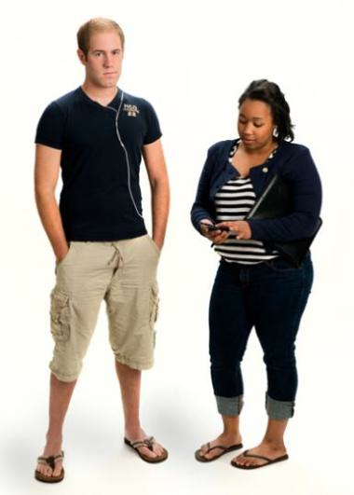

Appearance
OR

Slide 5
Preparedness
Apologizing?
Lots of notes?
Vocal fillers?
Confidence?
A few notes?
Pausing?
OR
PRACTICE!
PRACTICE!
PRACTICE!

Slide 6
Visuals
Poster board?
Foam board?
OR
PowerPoint?

Slide 7
The “Do’s & Don’ts” of
Using PowerPoint

Slide 8
Color
DO choose a color palette & stick with it.
DO use contrasting backgrounds & font.
DON’T use too much color as it will become distracting & appear inconsistent.

Slide 9
Text
DO keep it brief.
DON’T use more than 6 lines of text per slide.

Slide 10
Fonts
DO use clear, easy to read fonts.
  This is easy to read.
  This is not easy to read.
  Neither is this.
DO use the same fonts on all slides

Slide 11
Fonts
DON’T USE ALL CAPS.
  IT’S HARDER TO READ ALL CAPS
DON’T use more than 2 fonts on a single slide.

Slide 12
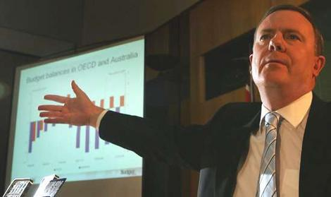
Images
DON’T use photos or images unless you really need them.

Slide 13


Images
DO use high-resolution images.

Slide 14
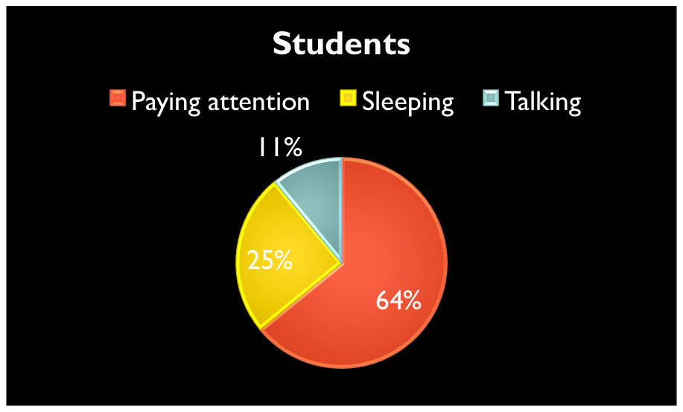
Images
DO keep them simple.
DO include titles on all charts/graphs.

Slide 15
Space
DO use the space on your slide effectively.
(Isn’t this a lot of dead space?)

Slide 16
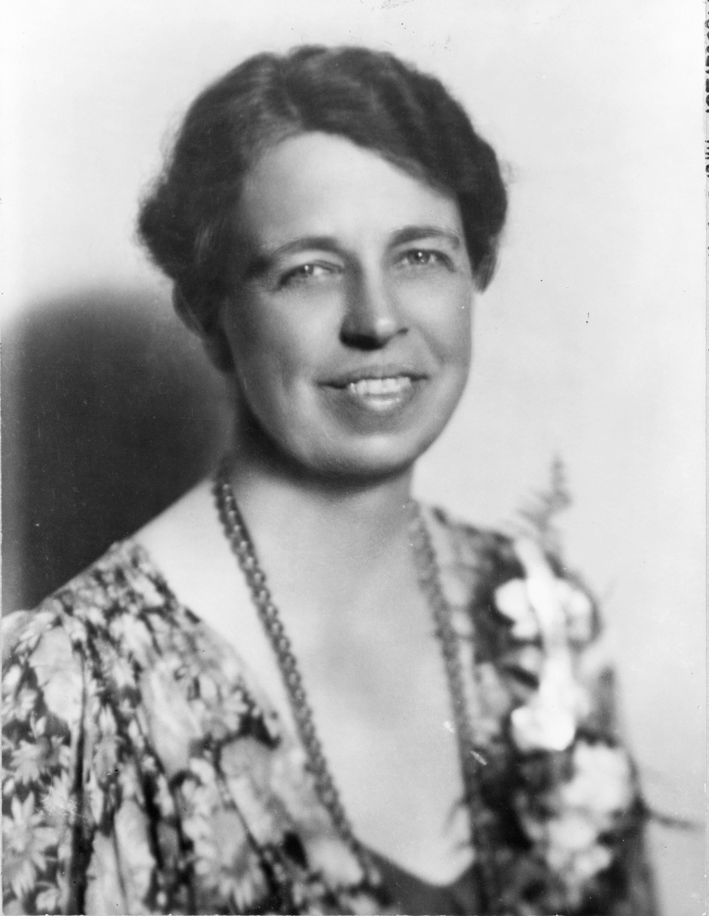
Eleanor Roosevelt
1884-1962
First Lady
Universal Declaration of Human Rights
Ambassador to the World

Slide 17
Eleanor Roosevelt
1884-1962
First Lady
Universal Declaration of Human Rights
Ambassador to the World

Slide 18
Animation
Animation is FUN!
Let’s use lots and lots and lots of it!
Because it’s FUUUUUUUNNNNN!!!!

Slide 19
Animation
DO use animation to enhance/emphasize certain information.
DO use animation to reveal & conceal information.
DON’T use animation if not necessary.
  It can be very distracting
  It makes text very hard to read

Slide 20
Sound
DO check to make sure any links to videos or audio clips work as expected.
DO check to make sure the volume to the speakers/projector are properly adjusted.
DON’T use sound with animations or slide changes unless necessary.
DON’T talk over audio links or sound bites.

Slide 21
One last thing…
DO proofread your slides.
  Its embarrassig to have a mispeling.

