Slide 1
Nouns: A Review

Slide 2
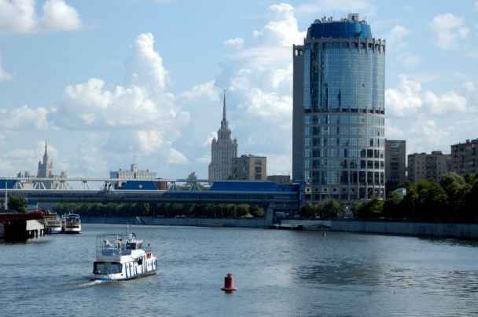
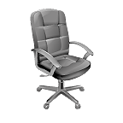
A noun is a word that names a person, place, thing, or idea.

Slide 3
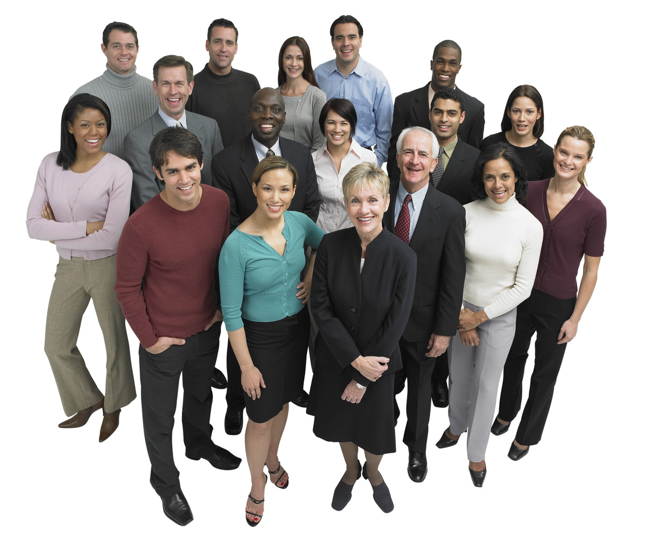
People
fireman
teacher
student
father
grandparent
criminal

Slide 4
Places
store
school
town
country
theater
club

Slide 5
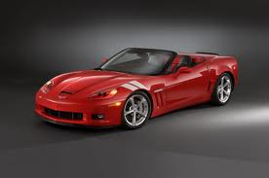
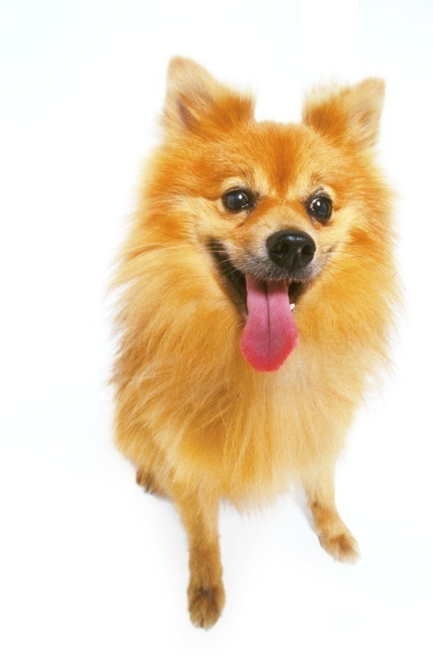
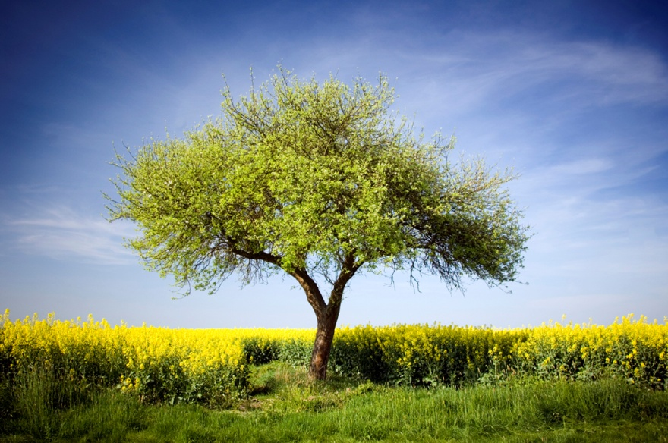
Things
dog
pencil
desk
book
car
tree

Slide 6
Ideas
bravery
honesty
democracy
religion
hatred
love

Slide 7
Concrete vs. Abstract
Concrete Nouns
Abstract Nouns
Usually people, places, or things and can be easily seen or touched.
student
school
desk
Ideas or qualities that cannot be seen or touched directly
happiness
fear
honor

Slide 8
Nouns can also be common or proper. Common nouns are nonspecific and are not capitalized. Proper nouns name a specific person, place, thing, or idea, and are capitalized.
Common
Proper
teacher
store
dog
religion
Mr. Sawyer
Target
German Shepherd
Islam

Slide 9
Nouns that are made up of more than one word are called compound nouns.
post office
ice cream
attorney-at-law
crosswalk
doorknob

Slide 10
Find all the nouns in the following sentences.
During springtime, flowers bloom.
The fragrance of the buds filled the air.
Bees are attracted to the perfume of the blossoms.
These insects see color, pattern, and movement.
Bees taste blooms with their front legs and antennae.

Slide 11
Find all the nouns in the following sentences.
During springtime, flowers bloom.
The fragrance of the buds filled the air.
Bees are attracted to the perfume of the blossoms.
These insects see color, pattern, and movement.
Bees taste blooms with their front legs and antennae.

Slide 12
Remember nouns now?

