Slide 1
Literary Devices (elements and Techniques) of fiction

Slide 2
Review: Literary Devices of Fiction
ELEMENTS
Setting
Mood
Plot
Flashback
Foreshadowing
TECHNIQUES
Allusion
Figurative Language
Simile
Metaphor
Imagery
Alliteration
Personification
Onomatopoeia
Hyperbole
Idiom
Dialogue
Literary device: A specific convention or structure that is employed by the author to produce a given effect, such as imagery, irony, or foreshadowing. Literary devices are important aspects of an author’s style.

Slide 3
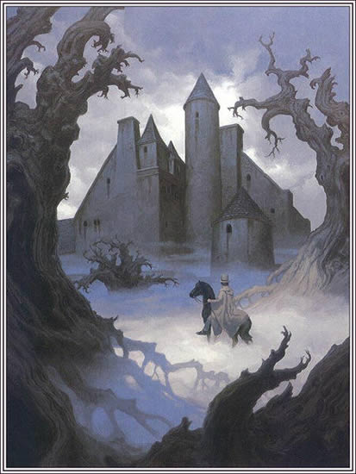
Setting (element)
The setting of a story is the time and place in which it occurs.
Elements of setting may include the physical, psychological, cultural, or historical background against which the story takes place.

Slide 4
Sensory Details (techniques)
Sensory details are details in writing that describe what is seen, heard, smelled, tasted, or touched.
Writers often use sensory details to enhance the mood and theme in writing.

Slide 5
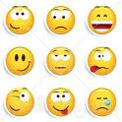
Mood (element)
The mood of a story is the atmosphere or feeling created by the writer and expressed through setting. (what the reader feels)

Slide 6
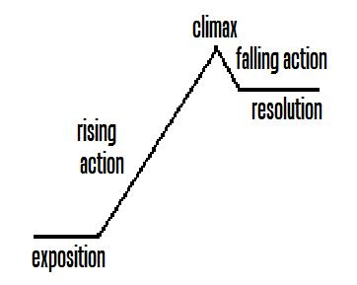
Plot (element)
Plot is the basic sequence of events in a story. In conventional stories, plot has three main parts: rising action, climax, and falling action.
Notes:
Find relevant examples to provide to students in explaining these definitions: (elaborate on definitions as you see appropriate)
Exposition—used at the beginning of a work to explain to the reader the background information needed to understand the characters and their circumstances.
Rising action—a series of conflicts and crisis that lead to the climax
Climax—the turning point of action in a piece of fiction, the greatest moment of tension
Falling action—events following the climax of a piece of fiction that eventually lead to the conclusion or denouement
Denouement—the resolution of the plot in a piece of fiction
In media res—stories beginning in the middle of action

Slide 7
Flashback (technique)
A flashback is a literary device by which a work presents material that occurred prior to the opening scene.
Various methods may be used such as recollections of characters, narration by the characters, dream sequences, and reveries.
Notes:
Harmon, W. H. (1996). A handbook to literature (7th Edition ed.). Upper Saddle River: Prentice-Hall, Inc.

Slide 8
Foreshadowing (technique)
Foreshadowing is hints to events that will occur later. The purpose of foreshadowing is to prepare the reader or viewer for action to come.
Foreshadowing can result from
the establishment of a mood or atmosphere,
an event that adumbrates the later action,
the appearance of physical objects or facts, or
the revelation of a fundamental and decisive character trait.
Notes:
Harmon, W. H. (1996). A handbook to literature (7th Edition ed.). Upper Saddle River: Prentice-Hall, Inc.

Slide 9
Allusion (techniques)
An allusion is a reference within a literary work to another work of literature, art, or real event. The reference is often brief and implied.
Mythological allusion—a direct or indirect reference to a character or event in mythology
Biblical allusion—a reference to a character or event from the bible

Slide 10
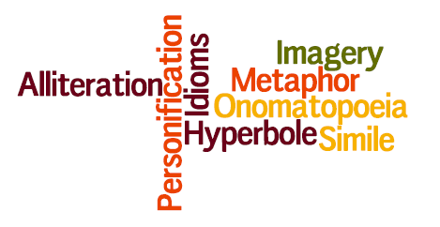
Figurative Language (technique)
Notes:
Figurative Language—Language layered with meaning by word images and figures of speech as opposed to literal language.
Image created on http://www.wordle.net

Slide 11
Figurative Language
Simile
Metaphor
A comparison of two
things that are
essentially different,
usually using the words
like or as.
Example: “Oh my love is like a red, red rose.” (from “A Red, Red
Rose” by Robert Burns)
A subtle comparison in which the author describes a person or thing using words that are not meant to be taken literally.
Example: “Time is a dressmaker specializing in alterations.” (Faith Baldwin)

Slide 12
Figurative Language
Imagery
Alliteration
The use of language to
create mental images and
sensory impressions.
Imagery can be used for
emotional effect and to
intensify the impact on the
reader.
Example: “such sweet sorrow”
The repetition of the
same sounds at the
beginning of two or more
adjacent words or stressed
syllables.
Example: “furrow followed free” (from The Rime of the Ancient Mariner by Samuel Taylor Coleridge)

Slide 13
Figurative Language
Personification
Onomatopoeia
Nonhuman things or
abstractions are
represented as having
human qualities.
Example: “A tree that may in summer wear a nest of robins in her hair”
(from “Trees” by Joyce Kilmer)
The use of words that
sound like what they
mean.
Example: “Hear the sledges with the bells— Silver bells!
What a world of merriment
their melody foretells! How they tinkle, tinkle, tinkle,
In the icy air of night!”
(from “The Bells” by Edgar
Allan Poe)

Slide 14
Figurative Language
Hyperbole
Idiom
An expression that has a
different meaning from
the literal meaning of its
individual words. Idioms
are particular to a given
language and usually
cannot be translated
literally.
Example:
Under the weather
An intentionally
exaggerated figure of
speech for emphasis or
effect.
Example:
"All the perfumes of Arabia
could not sweeten this
little hand."
(from Macbeth by William
Shakespeare)

Slide 15
Characterization
Characterization is the creation of imaginary persons so that they seem lifelike. There are three fundamental methods of characterization.
Notes:
Harmon, W. H. (1996). A handbook to literature (7th Edition ed.). Upper Saddle River: Prentice-Hall, Inc.

Slide 16
Characterization
The explicit presentation by the author of the character through direct description, either in an introductory block or more often piecemeal throughout the work, illustrated by action (external characterization).
Notes:
Harmon, W. H. (1996). A handbook to literature (7th Edition ed.). Upper Saddle River: Prentice-Hall, Inc.

Slide 17
Characterization
The presentation of a character in action, with little or no explicit comment by the author, in the expectation that the reader can deduce the attributes of the character from his/her actions (external characterization).
Notes:
Harmon, W. H. (1996). A handbook to literature (7th Edition ed.). Upper Saddle River: Prentice-Hall, Inc.

Slide 18
Characterization
The representation from within a character, without comment by the author, of the impact of actions and emotions on the character’s inner self (internal characterization).
Notes:
Harmon, W. H. (1996). A handbook to literature (7th Edition ed.). Upper Saddle River: Prentice-Hall, Inc.

Slide 19
Character Development
Internal Character Development
Feelings
Thoughts
Emotions
External Character Development
Actions
Relationships
Dialogues

Slide 20
Review: Literary Devices of Fiction
ELEMENTS
Setting
Mood
Plot
Flashback
Foreshadowing
TECHNIQUES
Allusion
Figurative Language
Simile
Metaphor
Imagery
Alliteration
Personification
Onomatopoeia
Hyperbole
Idiom
Dialogue
Literary device: A specific convention or structure that is employed by the author to produce a given effect, such as imagery, irony, or foreshadowing. Literary devices are important aspect’s of an author’s style.

Slide 21
Point of View-Narrator (element)
The narrator is the teller of a story.
Reliable narrator—the reader accepts the statements of fact and judgment without serious question
Unreliable narrator—the reader questions or seeks to qualify the statements of fact and judgment.
Notes:
Harmon, W. H. (1996). A handbook to literature (7th Edition ed.). Upper Saddle River: Prentice-Hall, Inc.

Slide 22
Point of View
The point of view is the perspective from which the events in the story are told. The author may choose to use any of the following:
Omniscient/third-person omniscient
Omniscient/third-person limited
Objective
First person/subjective
Limited

Slide 23
Point of View
Omniscient/third-person omniscient—The narrator tells the story in third person from an all-knowing perspective. The knowledge is not limited by any one character’s view or behavior, as the narrator knows everything about all characters.
Signal pronouns—he, she, they

Slide 24
Point of View
Omniscient/third-person limited—The narrator restricts his knowledge to one character’s view or behavior.
Signal pronouns—he, she, they
Objective—The narrator reveals only the actions and words without the benefit of the inner thoughts and feelings.
Signal pronouns—he, she, they

Slide 25
Point of View
First person/subjective—The narrator restricts the perspective to that of only one character to tell the story.
Signal pronouns—I, we, us
Limited—A narrative mode in which the story is told through the point of view of a single character and is limited to what he or she sees, hears, feels, or is told.
Signal pronouns—I, we, us

Slide 26
Theme (element)
The theme is the central or universal idea of a piece of fiction.
An implicit theme refers to the author’s ability to construct a piece in such a way that through inference the reader understands the theme.

Slide 27
Theme
The theme is also the main idea of a nonfiction essay.
An explicit theme refers to when the author overtly states the theme somewhere in the work.

Slide 28
Theme
A universal theme transcends social and cultural boundaries and speaks to a common human experience.
The human condition encompasses all of the experience of being human. The ongoing way in which humans react to or cope with these events is the human condition.
Notes:
http://www.reference.com/browse/human+condition

